Slide 1
Data Mining Classification: Alternative Techniques
Imbalanced Class Problem
Introduction to Data Mining, 2nd Edition
by
Tan, Steinbach, Karpatne, Kumar

Slide 2
Class Imbalance Problem
Lots of classification problems where the classes are skewed (more records from one class than another)
Credit card fraud
Intrusion detection
Defective products in manufacturing assembly line

Slide 3
Challenges
Evaluation measures such as accuracy is not well-suited for imbalanced class
Detecting the rare class is like finding needle in a haystack

Slide 4
Confusion Matrix
Confusion Matrix:
 | PREDICTED CLASS
ACTUAL CLASS |  | Class=Yes | Class=No
 | Class=Yes | a | b
 | Class=No | c | d
a: TP (true positive)
b: FN (false negative)
c: FP (false positive)
d: TN (true negative)

Slide 5
Accuracy
Most widely-used metric:
 | PREDICTED CLASS
ACTUAL CLASS |  | Class=Yes | Class=No
 | Class=Yes | a (TP) | b (FN)
 | Class=No | c (FP) | d (TN)

Slide 6
Problem with Accuracy
Consider a 2-class problem
(total number of test samples 10.000)
Number of Class 0 examples = 9990
Number of Class 1 examples = 10

Slide 7
Problem with Accuracy
Consider a 2-class problem
Number of Class NO examples = 990
Number of Class YES examples = 10
If a model predicts everything to be class NO, accuracy is 990/1000 = 99 %
This is misleading because the model does not detect any class YES example
Detecting the rare class is usually more interesting (e.g., frauds, intrusions, defects, etc)

Slide 8
Alternative Measures
 | PREDICTED CLASS
ACTUAL CLASS |  | Class=Yes | Class=No
 | Class=Yes | a | b
 | Class=No | c | d
Harmonic Mean of P and R

Slide 9
Alternative Measures
 | PREDICTED CLASS
ACTUAL CLASS |  | Class=Yes | Class=No
 | Class=Yes | 10 | 0
 | Class=No | 10 | 980

Slide 10
Alternative Measures
 | PREDICTED CLASS
ACTUAL CLASS |  | Class=Yes | Class=No
 | Class=Yes | 10 | 0
 | Class=No | 10 | 980
 | PREDICTED CLASS
ACTUAL CLASS |  | Class=Yes | Class=No
 | Class=Yes | 1 | 9
 | Class=No | 0 | 990

Slide 11
Alternative Measures
 | PREDICTED CLASS
ACTUAL CLASS |  | Class=Yes | Class=No
 | Class=Yes | 40 | 10
 | Class=No | 10 | 40

Slide 12
Alternative Measures
 | PREDICTED CLASS
ACTUAL CLASS |  | Class=Yes | Class=No
 | Class=Yes | 40 | 10
 | Class=No | 10 | 40
 | PREDICTED CLASS
ACTUAL CLASS |  | Class=Yes | Class=No
 | Class=Yes | 40 | 10
 | Class=No | 1000 | 4000

Slide 13
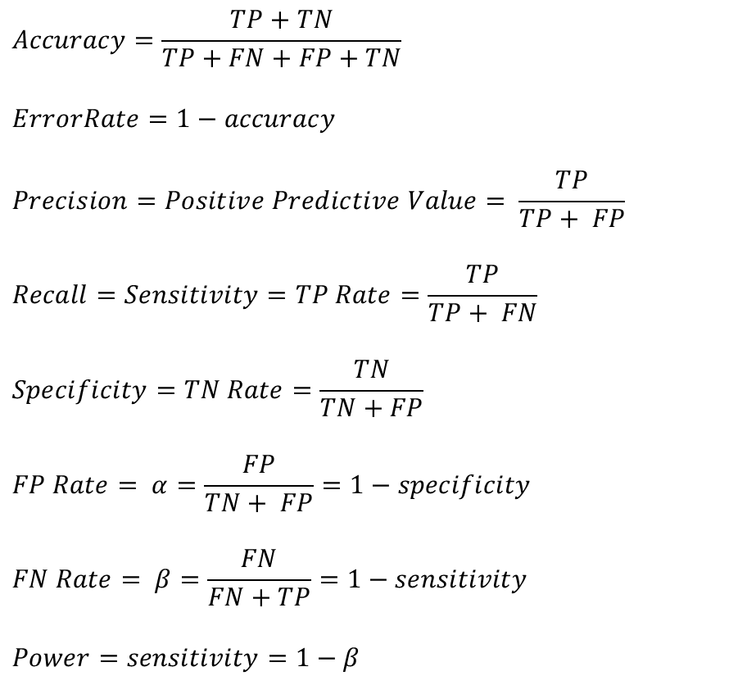
Measures of Classification Performance
 | PREDICTED CLASS
ACTUAL CLASS |  | Yes | No
 | Yes | TP | FN
 | No | FP | TN
α is the probability that we reject the null hypothesis when it is true. This is a Type I error or a false positive (FP).
β is the probability that we accept the null hypothesis when it is false. This is a Type II error or a false negative (FN).

Slide 14
Alternative Measures
 | PREDICTED CLASS
ACTUAL CLASS |  | Class=Yes | Class=No
 | Class=Yes | 40 | 10
 | Class=No | 10 | 40
 | PREDICTED CLASS
ACTUAL CLASS |  | Class=Yes | Class=No
 | Class=Yes | 40 | 10
 | Class=No | 1000 | 4000

Slide 15
Alternative Measures
 | PREDICTED CLASS
ACTUAL CLASS |  | Class=Yes | Class=No
 | Class=Yes | 10 | 40
 | Class=No | 10 | 40
 | PREDICTED CLASS
ACTUAL CLASS |  | Class=Yes | Class=No
 | Class=Yes | 25 | 25
 | Class=No | 25 | 25
 | PREDICTED CLASS
ACTUAL CLASS |  | Class=Yes | Class=No
 | Class=Yes | 40 | 10
 | Class=No | 40 | 10

Slide 16
ROC (Receiver Operating Characteristic)
A graphical approach for displaying trade-off between detection rate and false alarm rate
Developed in 1950s for signal detection theory to analyze noisy signals
ROC curve plots TPR against FPR
Performance of a model represented as a point in an ROC curve
Changing the threshold parameter of classifier changes the location of the point

Slide 17
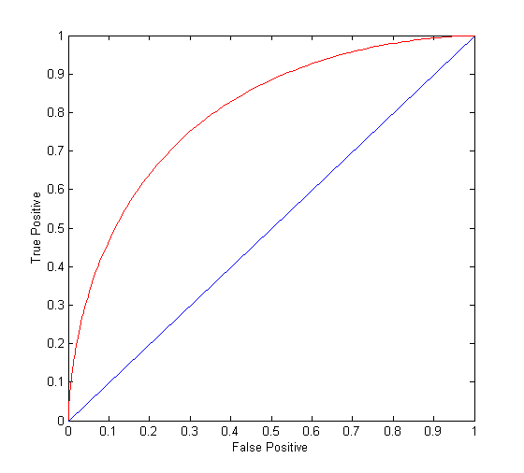
ROC Curve
(TPR,FPR):
(0,0): declare everything to be negative class
(1,1): declare everything to be positive class
(1,0): ideal
Diagonal line:
Random guessing
Below diagonal line:
prediction is opposite of the true class

Slide 18
ROC (Receiver Operating Characteristic)
To draw ROC curve, classifier must produce continuous-valued output
Outputs are used to rank test records, from the most likely positive class record to the least likely positive class record
Many classifiers produce only discrete outputs (i.e., predicted class)
How to get continuous-valued outputs?
Decision trees, rule-based classifiers, neural networks, Bayesian classifiers, k-nearest neighbors, SVM

Slide 19
Example: Decision Trees
Decision Tree
Continuous-valued outputs

Slide 20
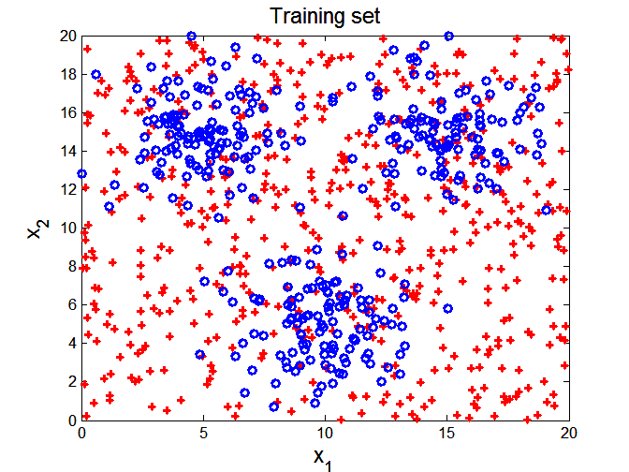

ROC Curve Example

Slide 21
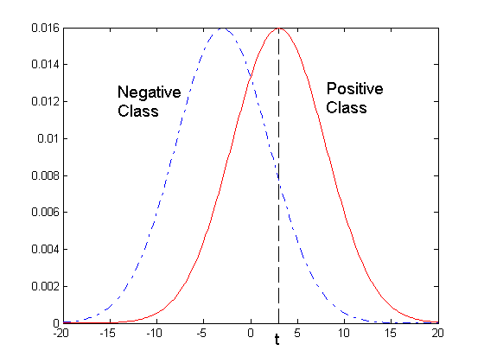
ROC Curve Example
- 1-dimensional data set containing 2 classes (positive and negative)
- Any points located at x > t is classified as positive
At threshold t:
TPR=0.5, FNR=0.5, FPR=0.12, TNR=0.88

Slide 22
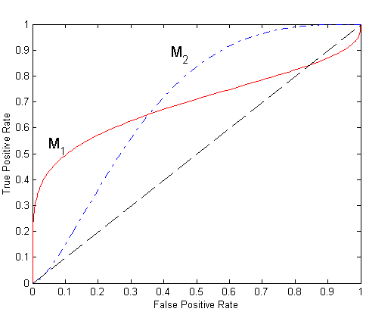
Using ROC for Model Comparison
No model consistently outperform the other
M₁ is better for small FPR
M₂ is better for large FPR
Area Under the ROC curve
Ideal:
Area = 1
Random guess:
Area = 0.5

Slide 23
How to Construct an ROC curve
Use a classifier that produces a continuous-valued score for each instance
The more likely it is for the instance to be in the + class, the higher the score
Sort the instances in decreasing order according to the score
Apply a threshold at each unique value of the score
Count the number of TP, FP, TN, FN at each threshold
TPR = TP/(TP+FN)
FPR = FP/(FP + TN)
Instance | Score | True Class
1 | 0.95 | +
2 | 0.93 | +
3 | 0.87 | -
4 | 0.85 | -
5 | 0.85 | -
6 | 0.85 | +
7 | 0.76 | -
8 | 0.53 | +
9 | 0.43 | -
10 | 0.25 | +

Slide 24
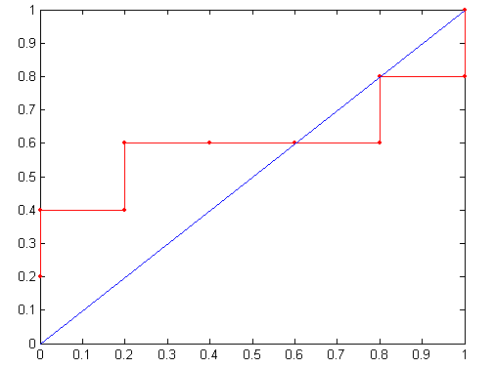
How to construct an ROC curve
Threshold >=
ROC Curve:

Slide 25
Handling Class Imbalanced Problem
Class-based ordering (e.g. RIPPER)
Rules for rare class have higher priority
Cost-sensitive classification
Misclassifying rare class as majority class is more expensive than misclassifying majority as rare class
Sampling-based approaches

Slide 26
Cost Matrix
 | PREDICTED CLASS
ACTUAL CLASS |  | Class=Yes | Class=No
 | Class=Yes | f(Yes, Yes) | f(Yes,No)
 | Class=No | f(No, Yes) | f(No, No)
C(i,j): Cost of misclassifying class i example as class j
Cost Matrix | PREDICTED CLASS
ACTUAL CLASS | C(i, j) | Class=Yes | Class=No
 | Class=Yes | C(Yes, Yes) | C(Yes, No)
 | Class=No | C(No, Yes) | C(No, No)

Slide 27
Computing Cost of Classification
Cost Matrix | PREDICTED CLASS
ACTUAL CLASS | C(i,j) | + | -
 | + | -1 | 100
 | - | 1 | 0
Model M₁ | PREDICTED CLASS
ACTUAL CLASS |  | + | -
 | + | 150 | 40
 | - | 60 | 250
Model M₂ | PREDICTED CLASS
ACTUAL CLASS |  | + | -
 | + | 250 | 45
 | - | 5 | 200
Accuracy = 80%
Cost = 3910
Accuracy = 90%
Cost = 4255

Slide 28
Cost Sensitive Classification
Example: Bayesian classifer
Given a test record x:
Compute p(i|x) for each class i
Decision rule: classify node as class k if
For 2-class, classify x as + if p(+|x) > p(-|x)
This decision rule implicitly assumes that C(+|+) = C(-|-) = 0 and C(+|-) = C(-|+)

Slide 29
Cost Sensitive Classification
General decision rule:
Classify test record x as class k if
2-class:
Cost(+) = p(+|x) C(+,+) + p(-|x) C(-,+)
Cost(-) = p(+|x) C(+,-) + p(-|x) C(-,-)
Decision rule: classify x as + if Cost(+) < Cost(-)
if C(+,+) = C(-,-) = 0:

Slide 30
Sampling-based Approaches
Modify the distribution of training data so that rare class is well-represented in training set
Undersample the majority class
Oversample the rare class
Advantages and disadvantages

